Slide 1

Revolutionizing Interviews with an Innovative Management System
- Mann Shah
- 191310132129
- ICT-B (B3)

Slide 2
Content
Introduction to Interview Management System
Problem Identification
Problem formulation and its Benefits of IMS
Work Done
Conclusion

Slide 3
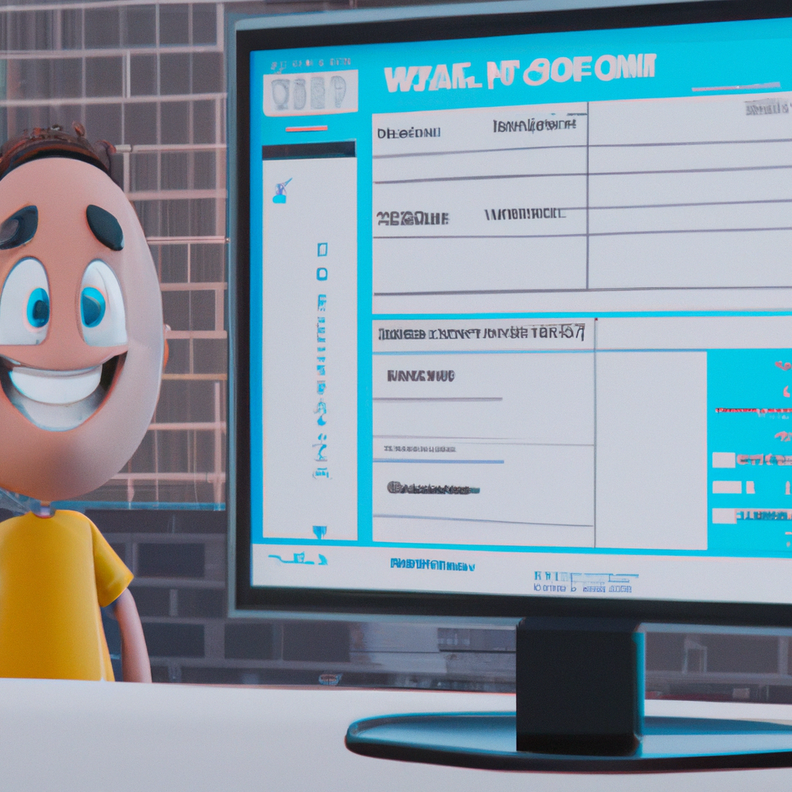
Introduction to Interview Management System
Interview Management System (IMS) is a comprehensive platform for managing the entire recruitment process. It helps recruiters to manage and track job applications, schedule interviews, and track the progress of candidates. It also allows for automated communication with candidates and offers a variety of tools for managing the recruitment process.
IMS simplifies the entire recruitment process, allowing recruiters to focus on the important task of finding the best candidate for the job.

Slide 4

Problem Identification
Without an IMS, recruiters must manually post job openings, review resumes, and schedule interviews.
This process can be time-consuming and prone to errors, especially when managing large volumes of applicants.
Additionally, scheduling interviews can be difficult and time-consuming, especially when coordinating with multiple candidates and interviewers

Slide 5

Problem Formulation and its Benefits of IMS
IMS offers a comprehensive suite of features to streamline the recruitment process. It will have three levels of accessibility.
Admin: The one who can manage the portal at the admin level with some admin-level grants that won't be visible to HR and Interviewer
HR: The whole process of recruiting, starting from Interview scheduling to hiring/rejecting candidates will be automated including multiple rounds of interviews.
Interviewer: The process of informing the interviewer about his scheduled interview will be automated.

Slide 6

Work Done.
Requirement gathering:
In the requirement phase of the project, we collected all the possible solutions for existing problems in our company and how we can implement them.
We are moving forward by taking the approach of a waterfall modal.
All requirements are listed and gathered.
Designing phase
System Design phase:
Mock-up screens are been built to have a concrete idea for the development phase.
Database design
Database designing that includes data dictionary, schema designing, relation mapping, normalization implementation, Keys, and much more information is about to complete before we jump to the development phase.

Slide 7

Conclusion
Interview Management System is a comprehensive platform for managing the entire recruitment process. It simplifies the recruitment process and offers a variety of tools for managing the process, including job postings, interview scheduling, and automated communication with candidates.
IMS is a secure and efficient platform for managing the recruitment process and offers a range of benefits to recruiters and candidates alike.

